Slide 1
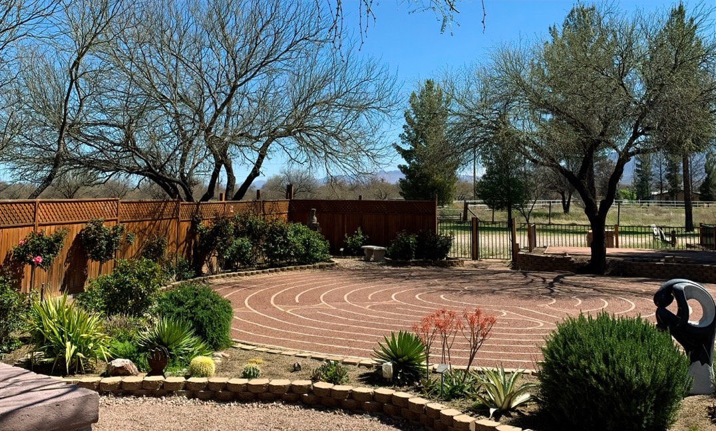
Welcome to Borderlands
Unitarian Universalist!
October 18th, 2026
0

Slide 2
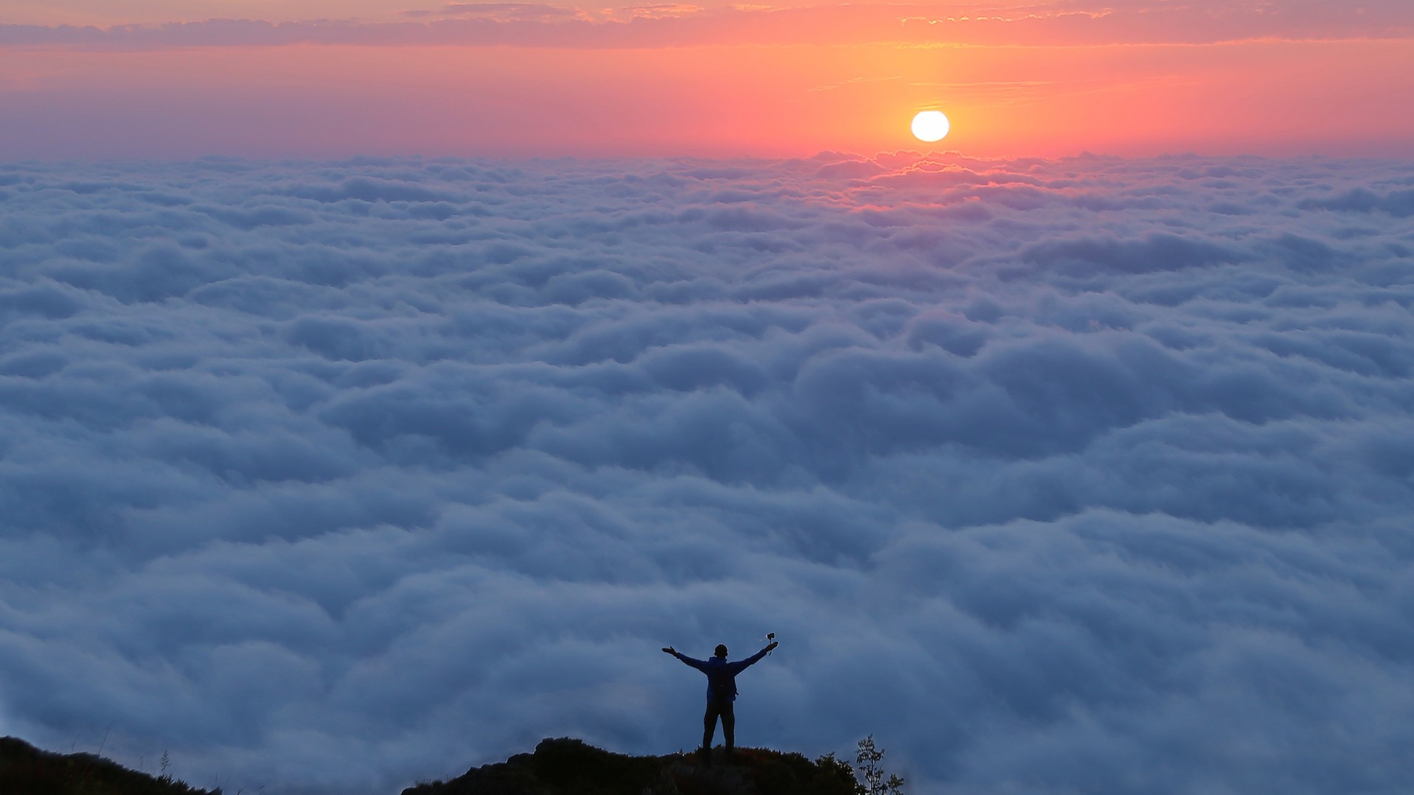
Spiritual Practice of
Awe
0

Slide 3
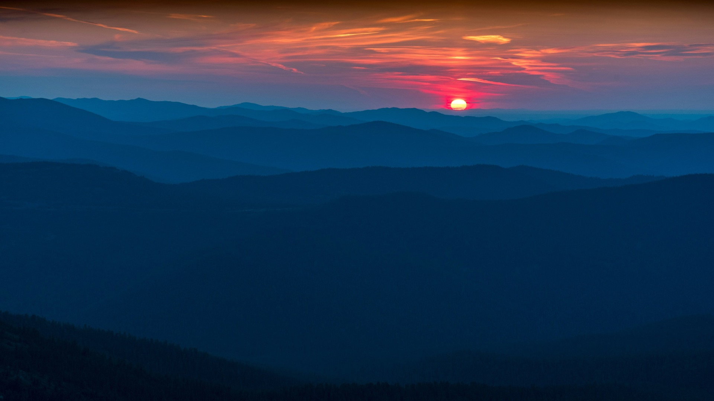
1
Prelude
When it is
Cactus Time
in Arizona
1.

Slide 4

Elaine Webber
2.

Slide 5
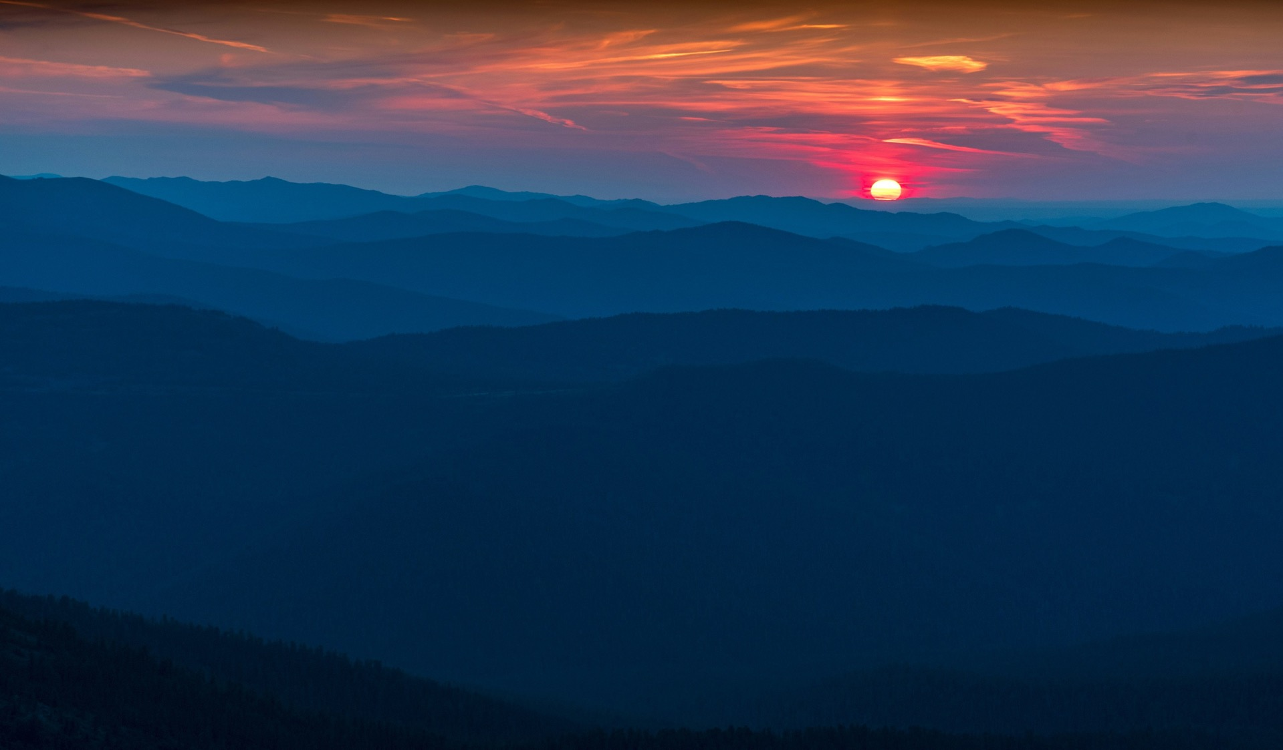
Opening Words

Slide 6


Hymn: #188 Gray
“Come, Come Whoever You Are,
Wander, worshiper, Lover of Learning,
Ours is no caravan of Despair,
Come yet again come.”
3
(Repeat 3 times)

Slide 7
Chalice Lighting
“

Slide 8
Congregational Hymn
#148 Let Freedom span both East and West
“

Slide 9

Together with love we covenant:
1. To respect one another with our words and actions,
2. To support this congregation with our presence, gifts, and service, and
3. To care for each other and the long-term well- being of our community
BUU COVENANT:

Slide 10
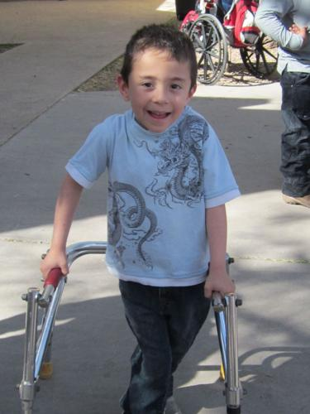
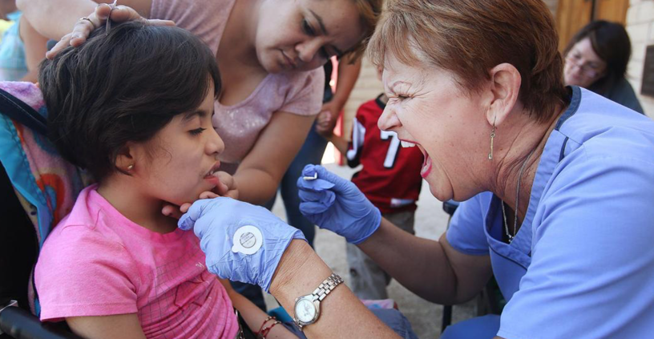
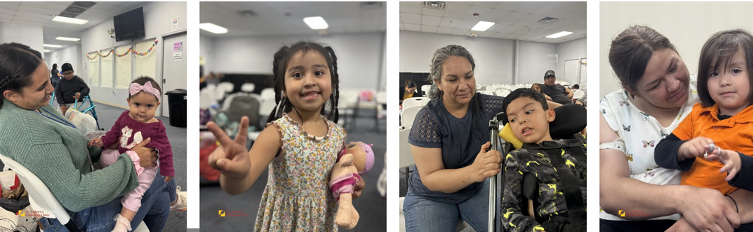

50% / 50% Offertory
Saint Andrews Children’s Clinic

Slide 11
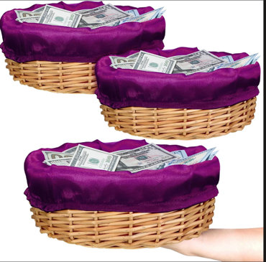
Offertory Affirmation
With gatitude for the abundance in our own lives, we give for the life of this conregation and our community

Slide 12
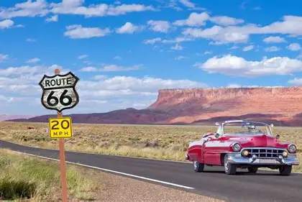

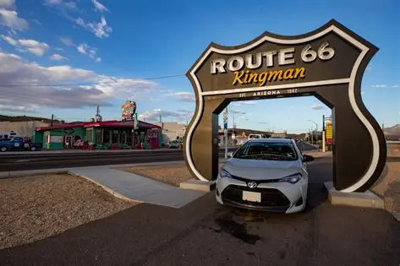
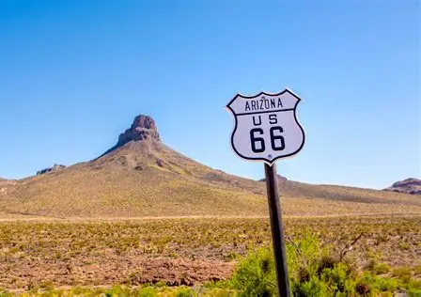
Offertory Music
Route 66

Slide 13
The Spiritual Practice of Awe
Rev. Kathleen Day

Slide 14

Leader: Come, all who are weary, all who are seeking--Pause, breathe, and look around

Slide 15
Congregation: We gather to remember that we live in a world filled with mystery and beauty, a world that still stirs awe in our hearts.

Slide 16
Leader: From the tiniest seed to the vast night sky, from whispered prayers to thunder’s roar.
People: We gather to remember that we live in a world filled with mystery and beauty, a world that still stirs awe in our hearts.

Slide 17

Congregation: We come with open hearts and wide eyes, ready to be surprised by beauty, awe and possibility.

Slide 18

Leader: Let us awaken to the sacred in the ordinary, and the holy in the everyday.

Slide 19
Congregation: Let us respond with awe, reverence and joy.

Slide 20
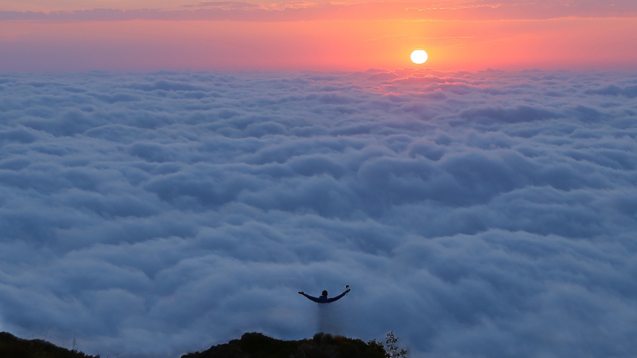

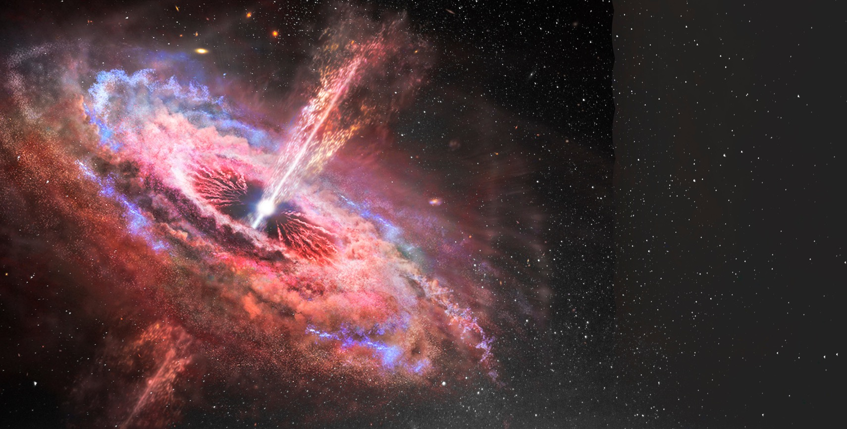

“If you think of feelings you have when you are awed by something
– for example, knowing
that elements in your body trace
to exploded stars –
I call that a spiritual reaction,
speaking of awe and majesty,
where words fail you.”
—Neil deGrasse Tyson
“If you think of feelings you have when you are awed by something – for example, knowing
that elements in your body trace to exploded stars – I call that a spiritual reaction,
speaking of awe and majesty, where words fail you.”—Neil DeGrasse Tyson
Spiritual Practice of AWE

Slide 21
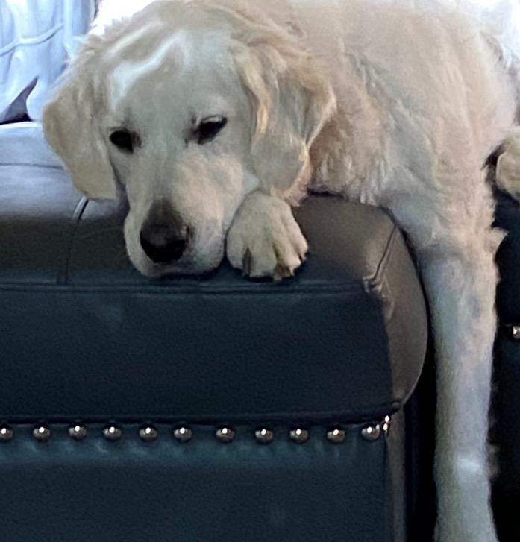
As a species, we
are prone to attending to that which we dread and fear.
It helped keep us alive.
But now the frequency of bad news is off the charts and it isn’t keeping us alive, rather it is quietly draining the life
right out of us.
“If you think of feelings you have when you are awed by something – for example, knowing
that elements in your body trace to exploded stars – I call that a spiritual reaction,
speaking of awe and majesty, where words fail you.”—Neil DeGrasse Tyson
Spiritual Practice of AWE

Slide 22
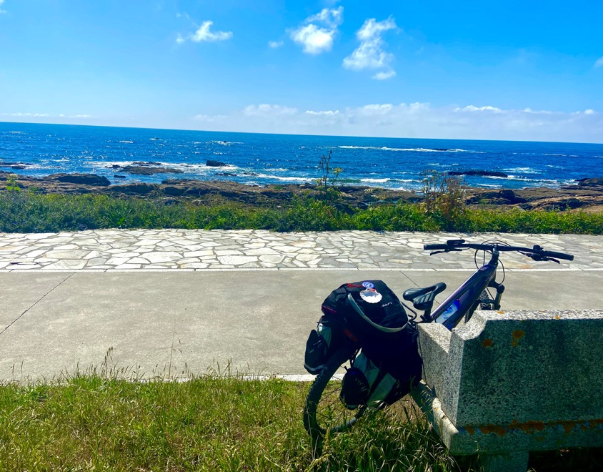
The spiritual practice of awe invites us to
heighten our connection to that which is bigger than us, remind us
that we are not
alone, and offer us respite and resilience.
“If you think of feelings you have when you are awed by something – for example, knowing
that elements in your body trace to exploded stars – I call that a spiritual reaction,
speaking of awe and majesty, where words fail you.”—Neil DeGrasse Tyson
Spiritual Practice of AWE

Slide 23
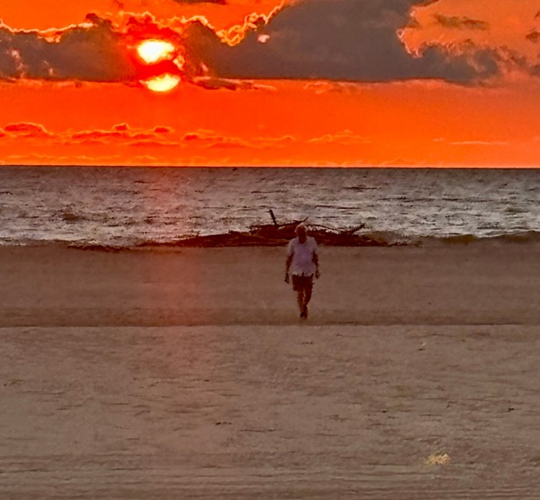
We might consider a spiritual practice of cultivating a state of awe about the lives we’ve been given
and revel in the sheer miracles of life that surround us.
“If you think of feelings you have when you are awed by something – for example, knowing
that elements in your body trace to exploded stars – I call that a spiritual reaction,
speaking of awe and majesty, where words fail you.”—Neil DeGrasse Tyson
Spiritual Practice of Awe

Slide 24

Researchers who study wellbeing know that
when we cultivate elements
that deepen our awe of life,
our appreciation for others,
our dedication to the good,
we live longer, more
purposeful and more joyful lives.
“If you think of feelings you have when you are awed by something – for example, knowing
that elements in your body trace to exploded stars – I call that a spiritual reaction,
speaking of awe and majesty, where words fail you.”—Neil DeGrasse Tyson
Spiritual Practice of AWE

Slide 25
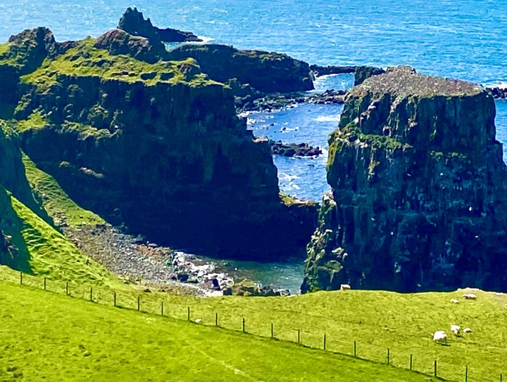

Slide 26
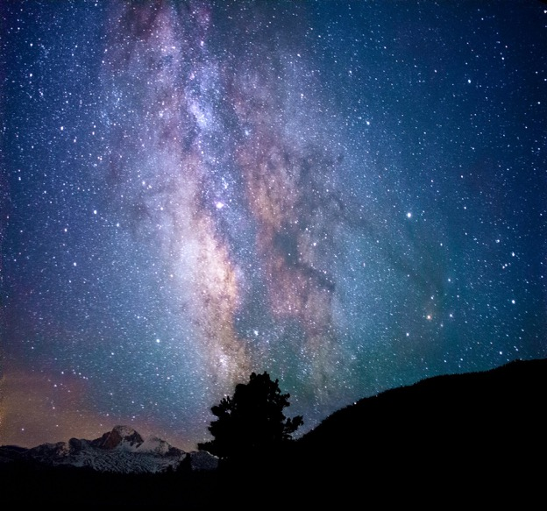

Slide 27
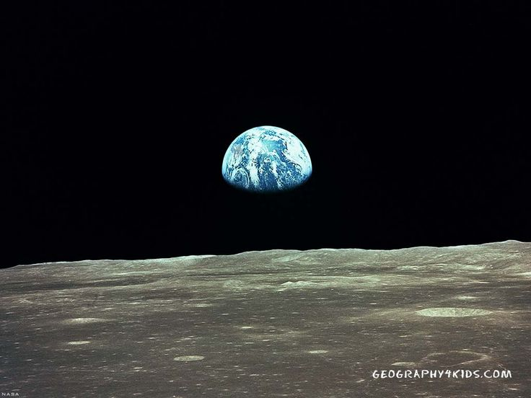

Slide 28
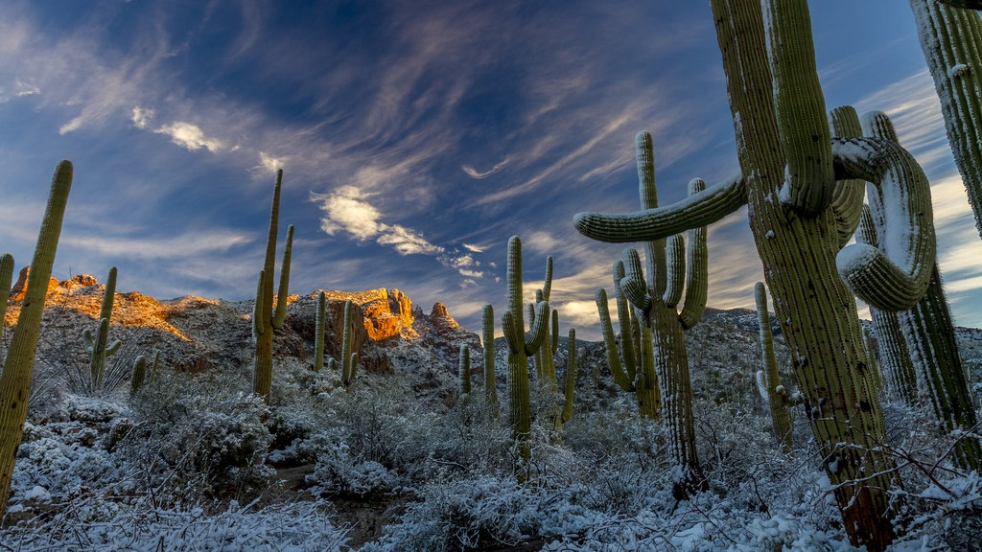
Spirit of life, come unto me.
Sing in my heart all the stirrings of compassion.
Blow in the wind, rise in the sea; move in the hand, giving life the shape of justice.
ROOTS hold me close. Wings set me free.
SPIRIT of Life, come to me, come to me.
This Photo by Unknown Author is licensed under CC BY

Slide 29
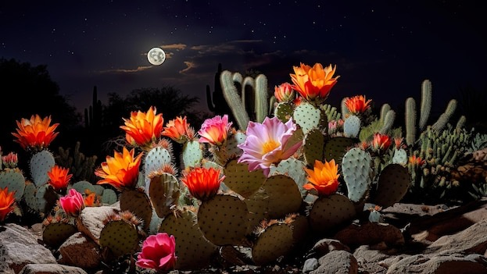
Fuente de-amor,
Ven hacia mí, Y’al corazón, cántale tu compasión.
Sopla-al volar, sube-en la mar, hasta molde-ar la justicia de la vida.
Arráigame, libérame, fuente de-amor, ven a mí, ven a mí.

Slide 30
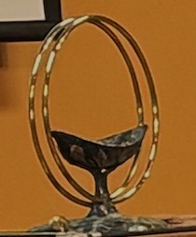


Extinguishing the Chalice

Slide 31
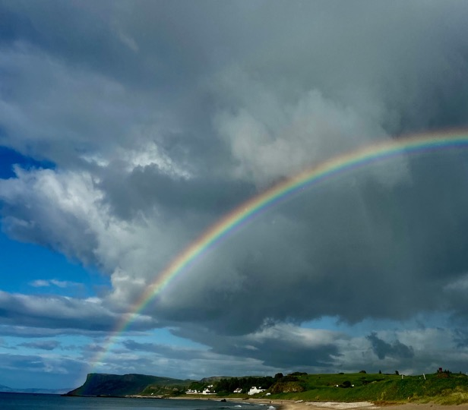
Postlude
Les Sylphides Mazurka

Slide 32
Benediction /Closing words:

Slide 33


