Slide 1
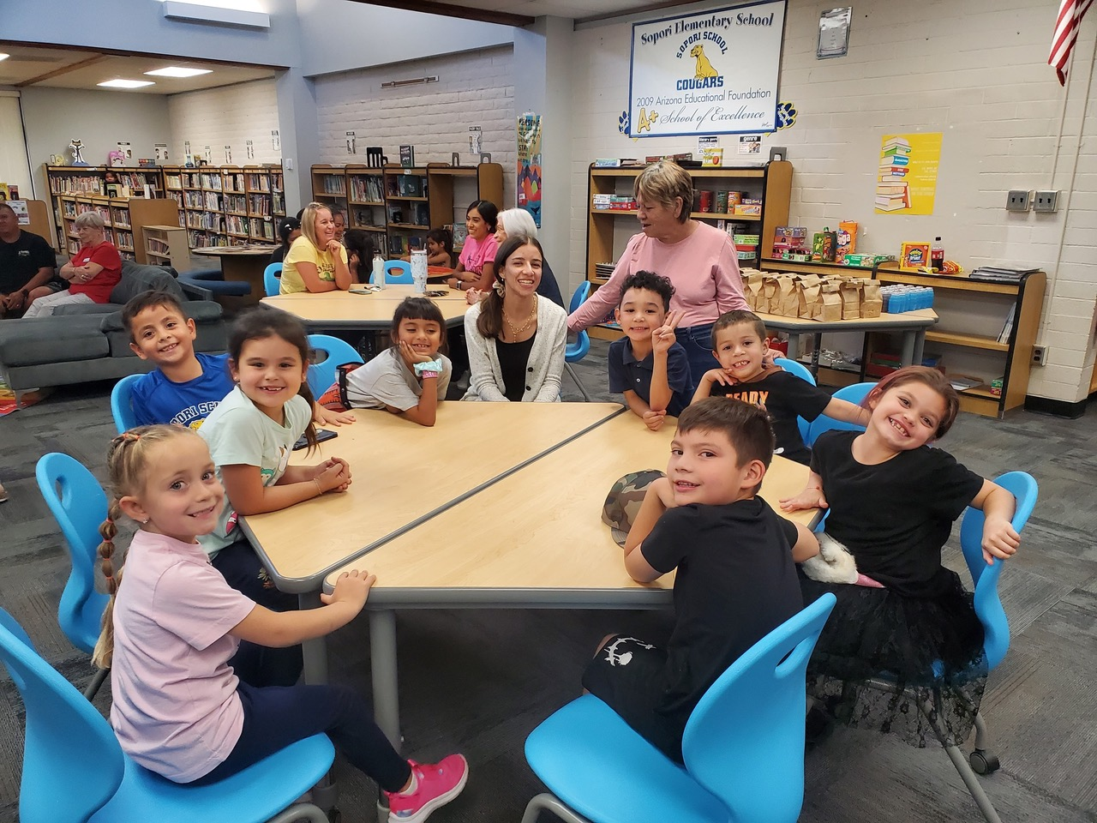
BORDERLANDS UU
Education– An Investment in Human Potential
August 2, 2026

Slide 2
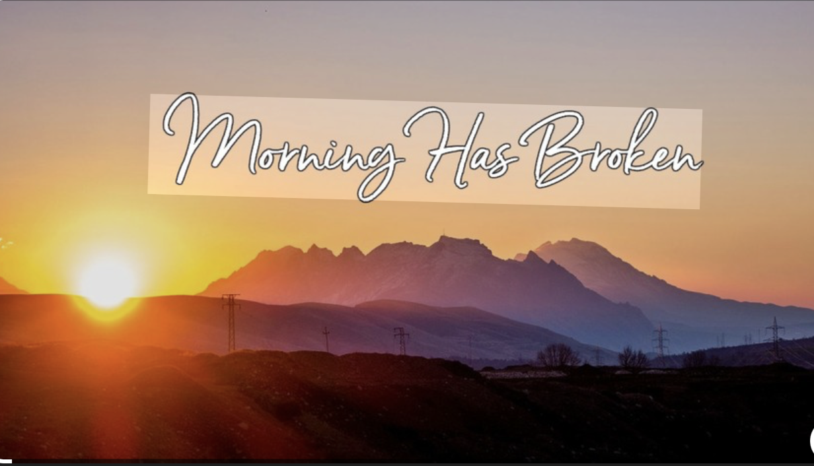
PRELUDE

Slide 3


Slide 4
Come, Come Whoever You Are
Come, come whoever you are
Wanderer, Worshipper
Lover of Leaving
Ours is no caravan of despair
Come, yet again, come.

Slide 5
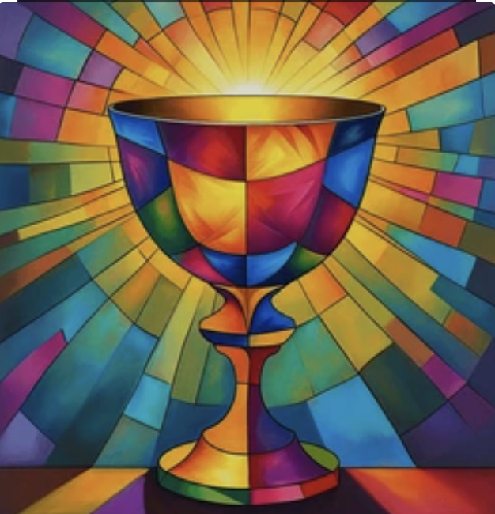
Chalice
Lighting

Slide 6
Together with love we covenant
To respect one another
With our words and actions,
To support this congregation
With our presence, gifts and service
And to care for each other
And the long-term well-being
Of our community.

Slide 7

Singing Together:
Touch the Earth, #301

Slide 8
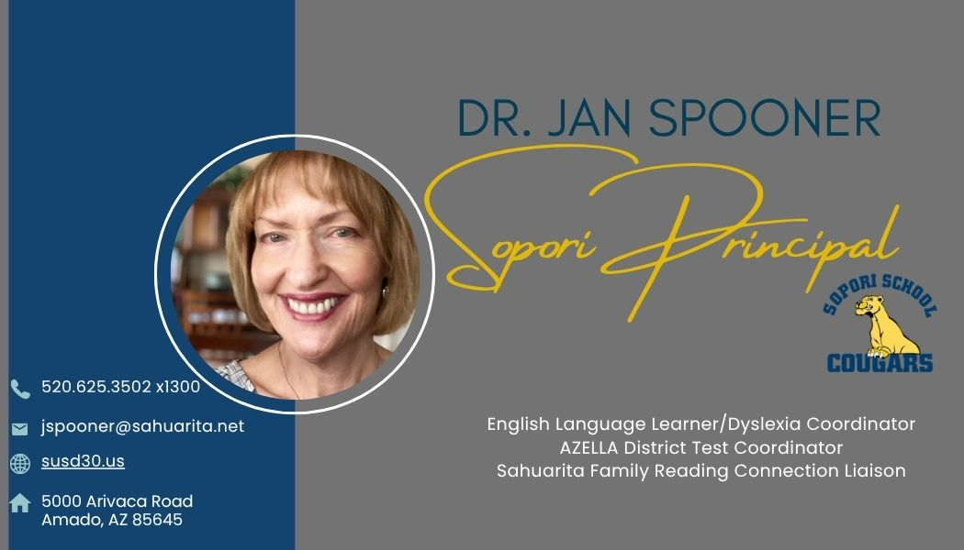
Introduction of Speakers

Slide 9
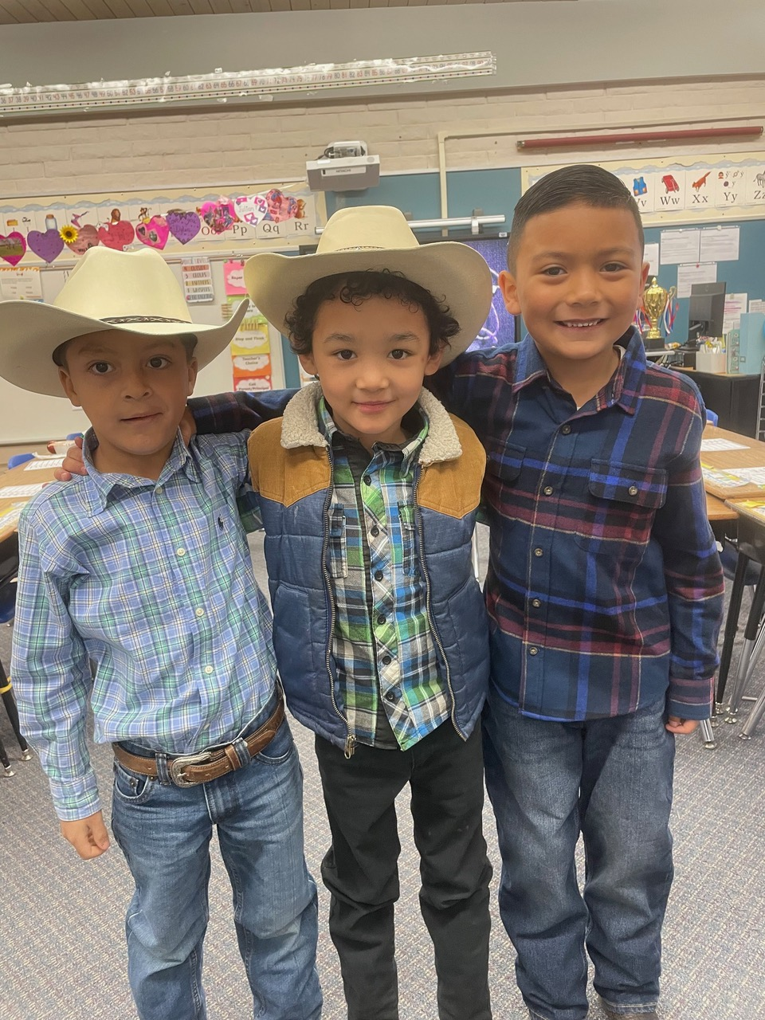
Offertory
Sopori School

Slide 10
With gratitude for the abundance in our own lives we give for the life of this congregation and our community.
Affirmation

Slide 11
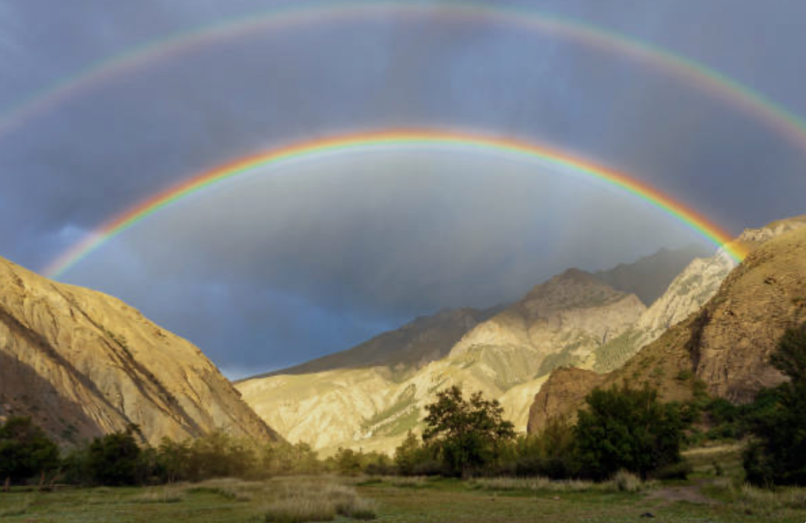
Offertory Music: Rainbow Connection

Slide 12
Singing Together
How Could Anyone,
Teal Hymnal 1053

Slide 13

Reflections

Slide 14
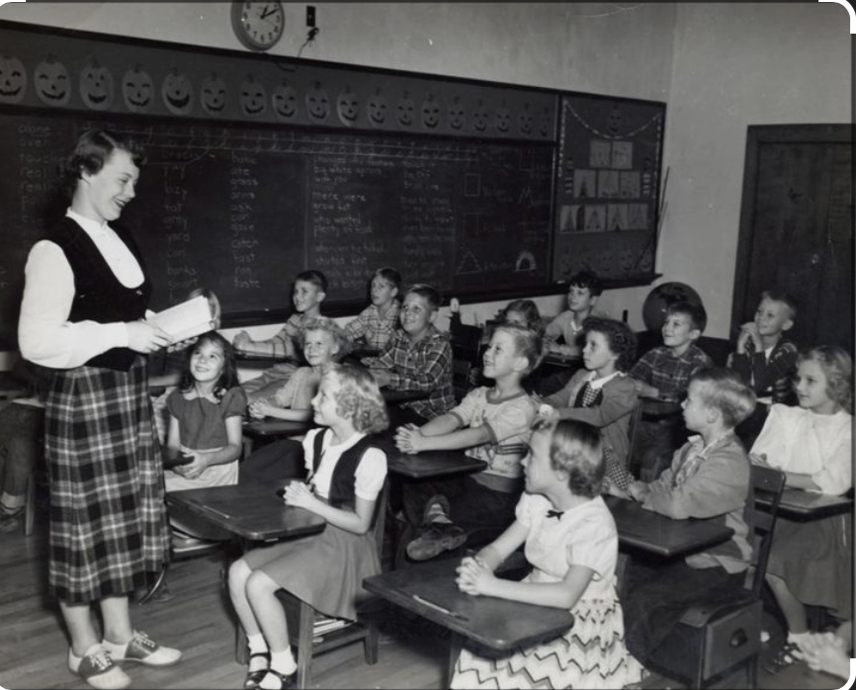
Meditation

Slide 15

Spirit of Life, Come to me
Sing in my heart
All the stirrings of compassion
Blow in the wind
Rise in the sea
Move in the hand
Giving life the shape of justice.
Roots hold me close
Wings set me free
Spirit of life
Come to me, come to me

Slide 16
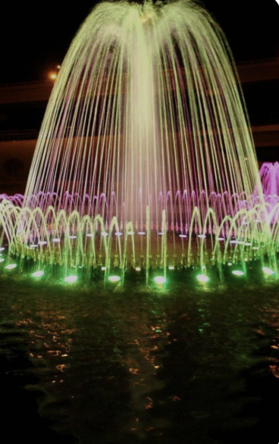
Fuente de amor
Ven hacia mí
Y’al corazon
Cantale tu compassión.
Sopla al volar
Sube en la mar
Hasta moldear
La justicia de la vida.
Arráigame, libérame
Fuente de amor
Ven a mí, ven a mí

Slide 17
Chalice
Extinguishing

Slide 18
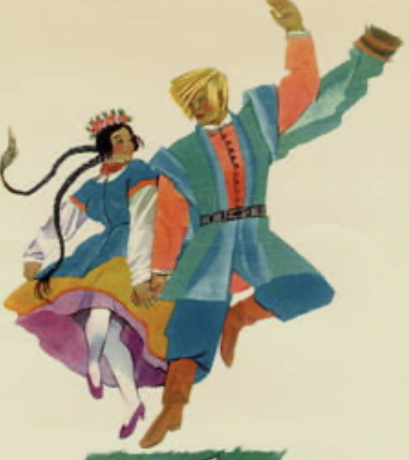
Postlude
Mazurka in B Flat Major
Frederic Chopin

