Slide 1
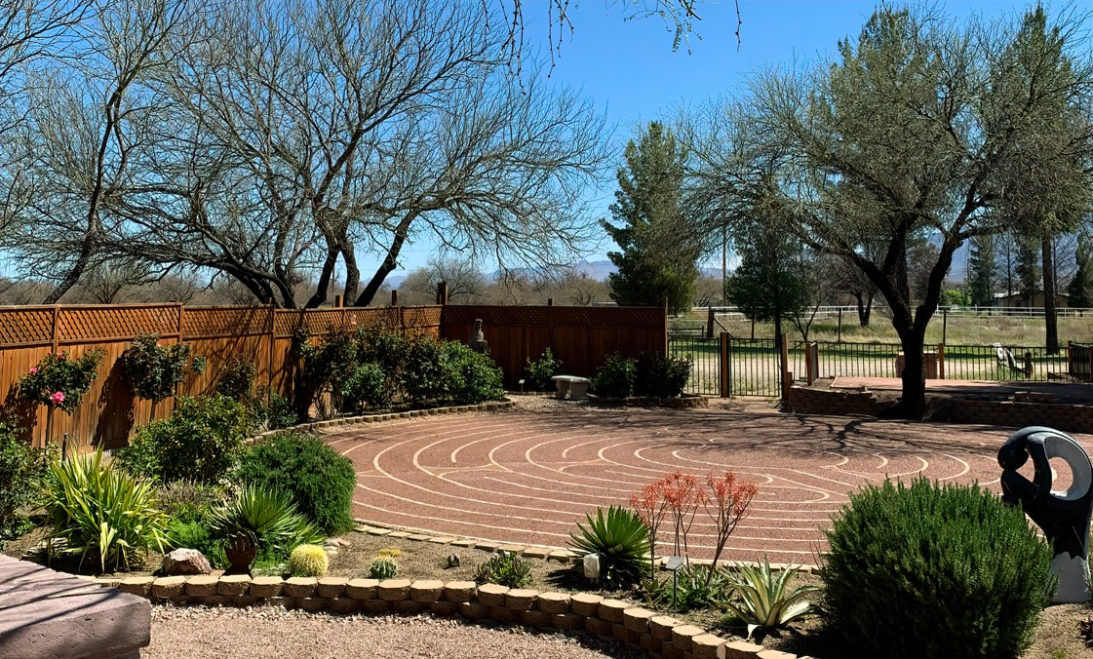
Welcome to Borderlands
Unitarian Universalist!
Date goes here
April 7, 2024

Slide 2

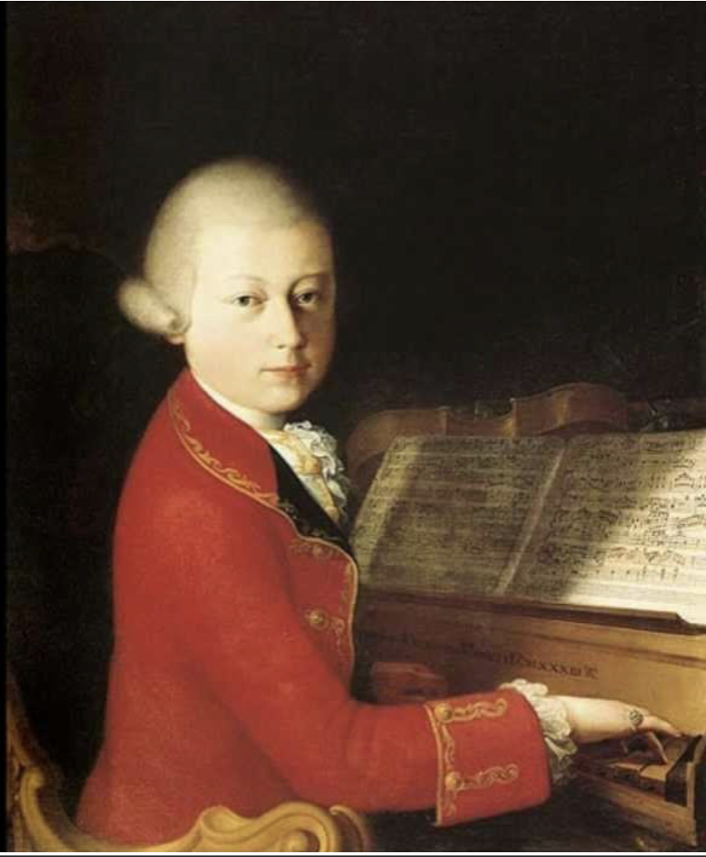
Prelude:
Minuet in G and Minuet in B Flat, Mozart

Slide 3


Slide 4

Hymn: #188 Gray
“Come, Come Whoever You Are,
Wander, worshiper, Lover of leaving,
Ours is no caravan of Despair,
Come yet again come.”

Slide 5


Slide 6
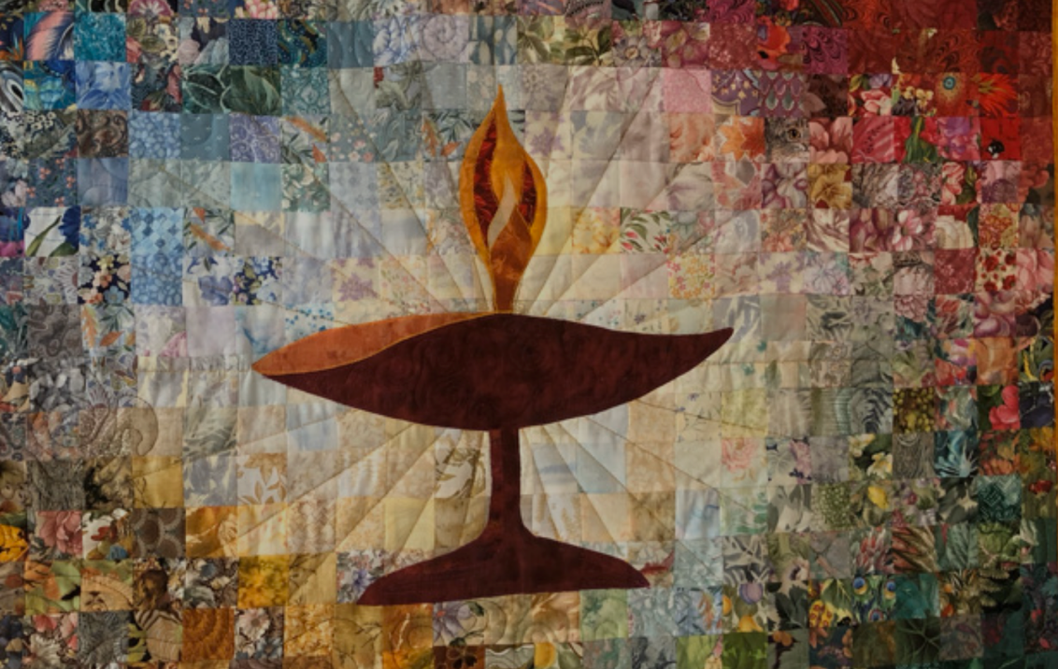
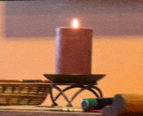
Chalice Lighting
John Harmer
Jim Lund

Slide 7

Speaker: Richard Bolivar,
Comparative Cultures

Slide 8
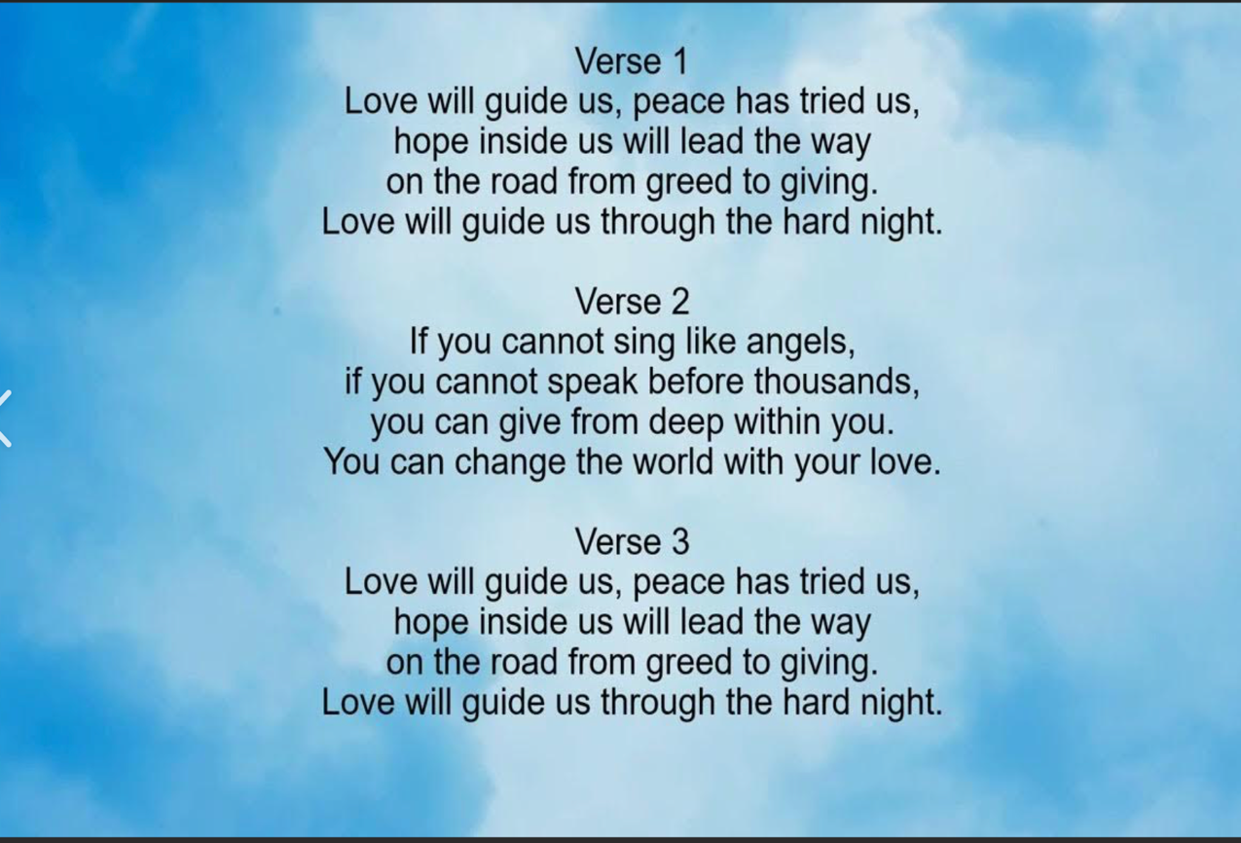

(#131 in the gray hymnal)
Love Will Guide Us, Sally Rogers

Slide 9
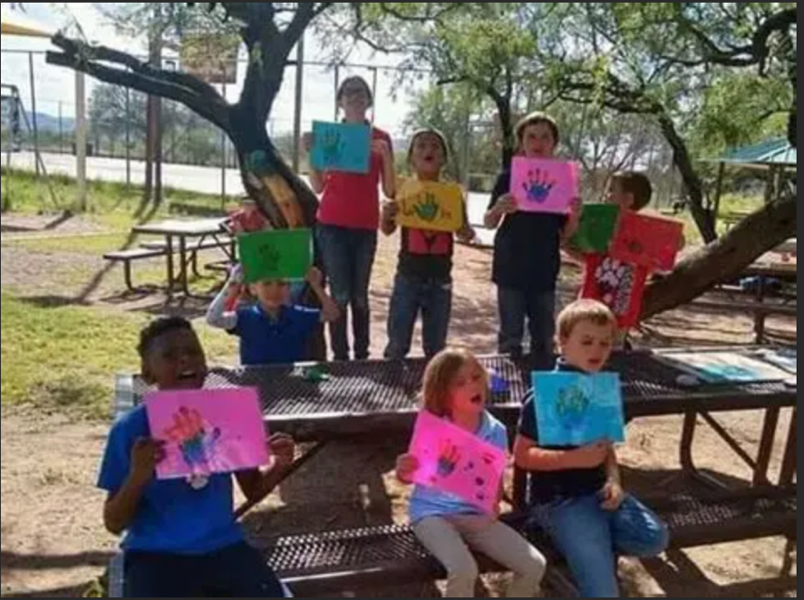
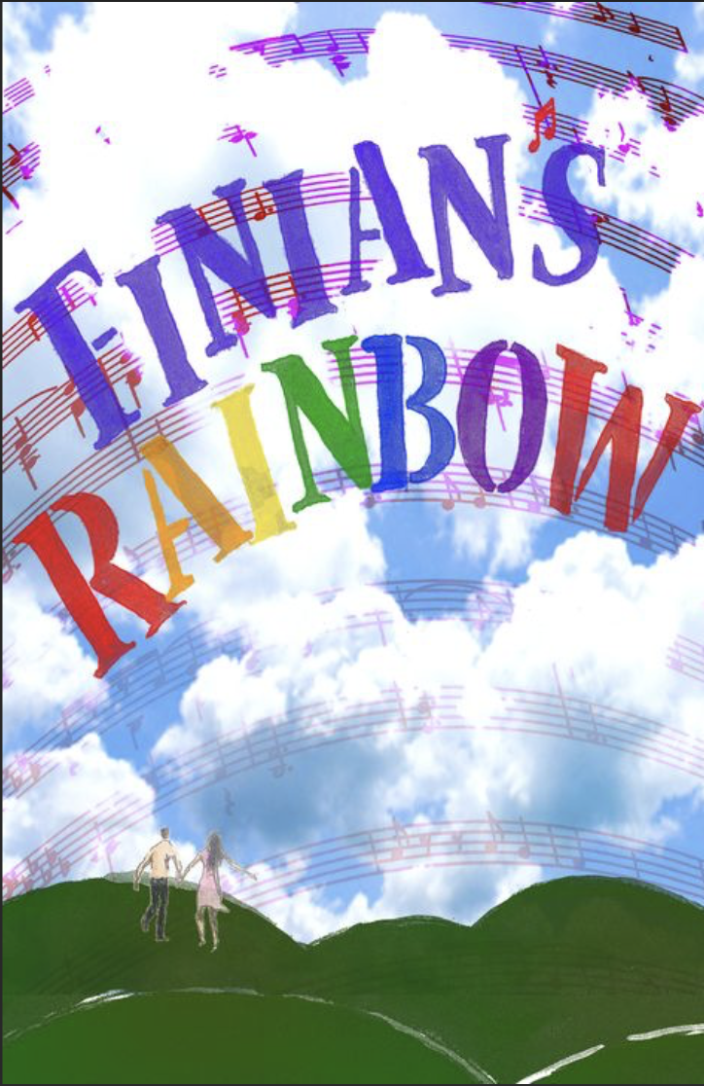
50/50 Offertory
Arivaca Early Learning Center
Offertory Music:
Look to the Rainbow from Finian’s Rainbow

Slide 10
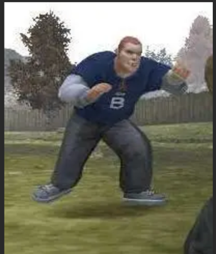
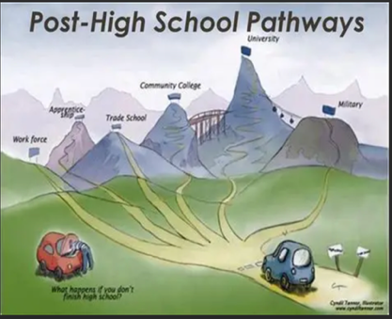


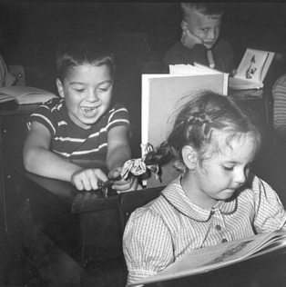
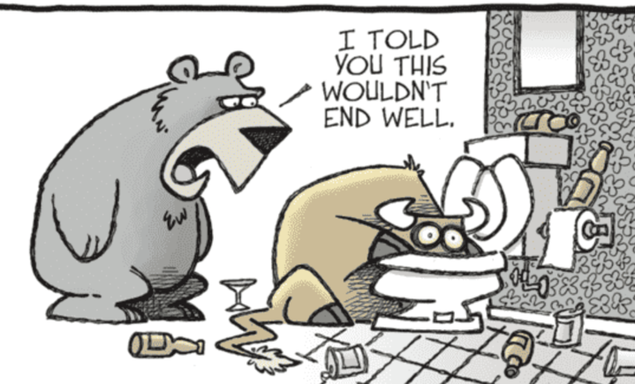

Speaker: Jack Webber, Story for all ages
Jack and Jill and Bill and what it takes for boys to become good men.

Slide 11

Together with love we covenant:
1. To respect one another with our words and actions,
2. To support this congregation with our presence, gifts, and service, and
3. To care for each other and the long-term well- being of our community
BUU COVENANT:

Slide 12
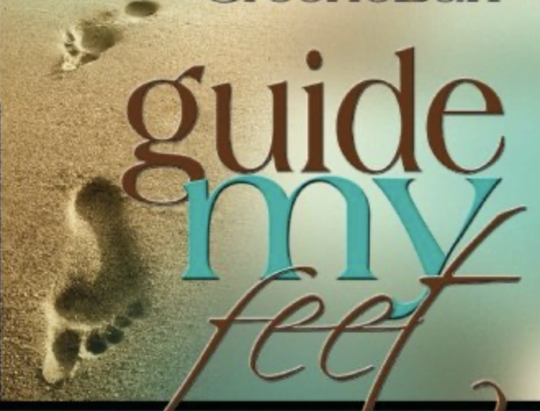
Hymn - (#348 in the gray hymnal
Guide My Feet Willis James

Slide 13
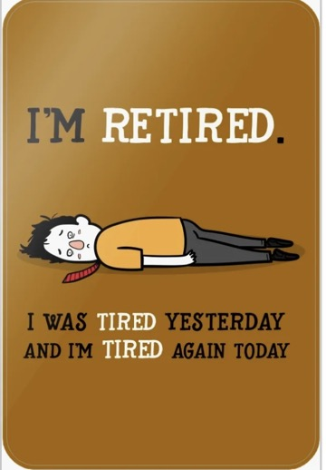

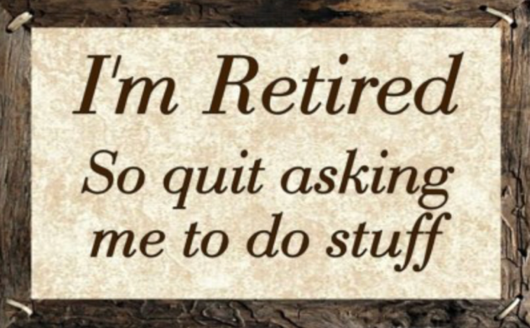
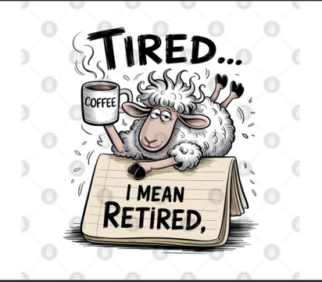


Speaker: George Smith,
Tired or Retired

Slide 14
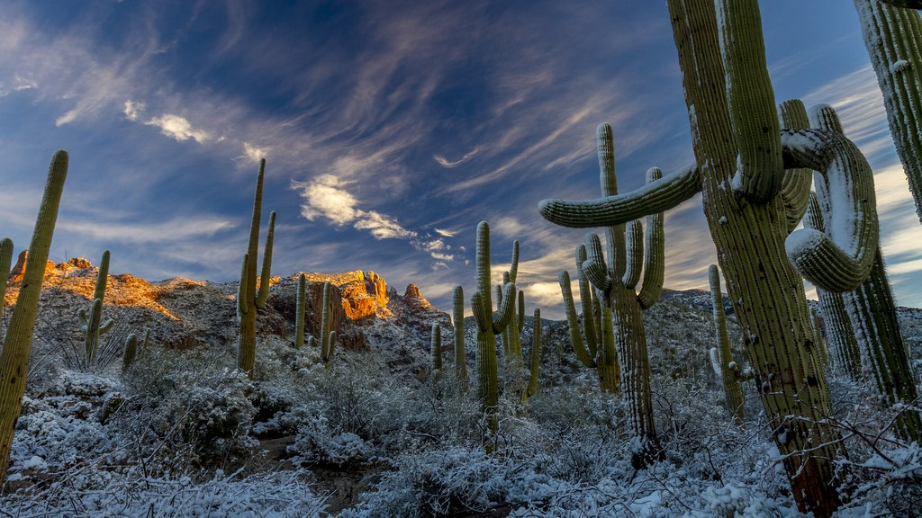
Spirit of life, come unto me.
Sing in my heart all the stirrings of compassion.
Blow in the wind, rise in the sea; move in the hand, giving life the shape of justice.
ROOTS hold me close. Wings set me free.
SPIRIT of Life, come to me, come to me.
This Photo by Unknown Author is licensed under CC BY

Slide 15
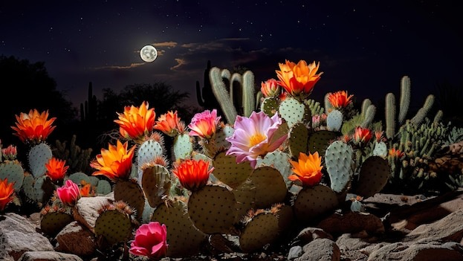
Fuente de-amor,
Ven hacia mí, Y’al corazón, cántale tu compasión.
Sopla-al volar, sube-en la mar, hasta molde-ar la justicia de la vida.
Arráigame, libérame, fuente de-amor, ven a mí, ven a mí.

Slide 16

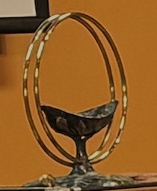
Extinguishing the Chalice
A Poem by Richard Bolivar

Slide 17
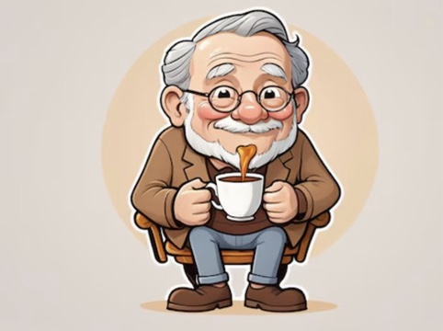
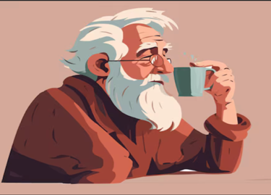


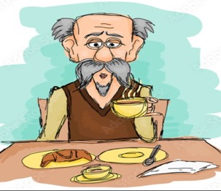


Postlude:
Michael King, Denny Boots, Stan Mass, David Doyle, John Asley,
Jim Hoy,
Ken Lopez, Gary Tepe, Randy Mitchell,
John Lazaruk John Kron,
Cliff Mayfield, Charlie Golec, Jim Fearnside
Etc.
That Old Gang of Mine,
Ziegfeld Follies

