Slide 1
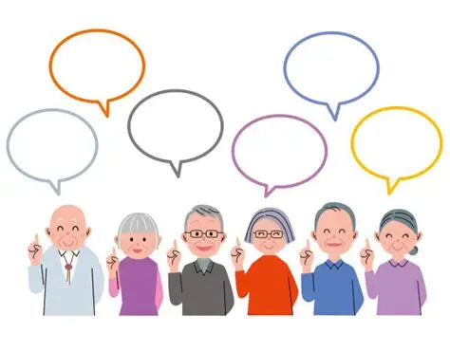
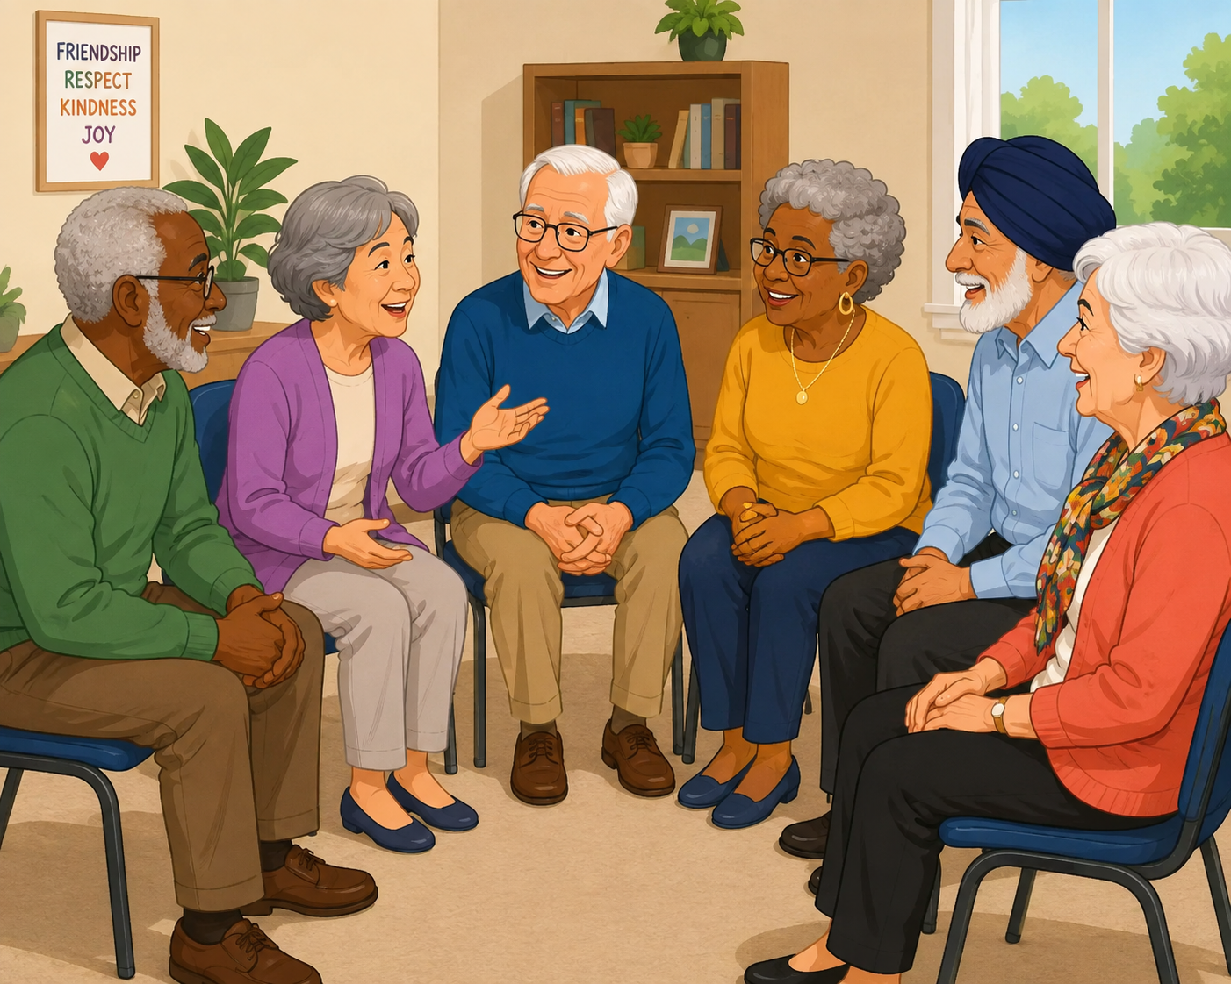
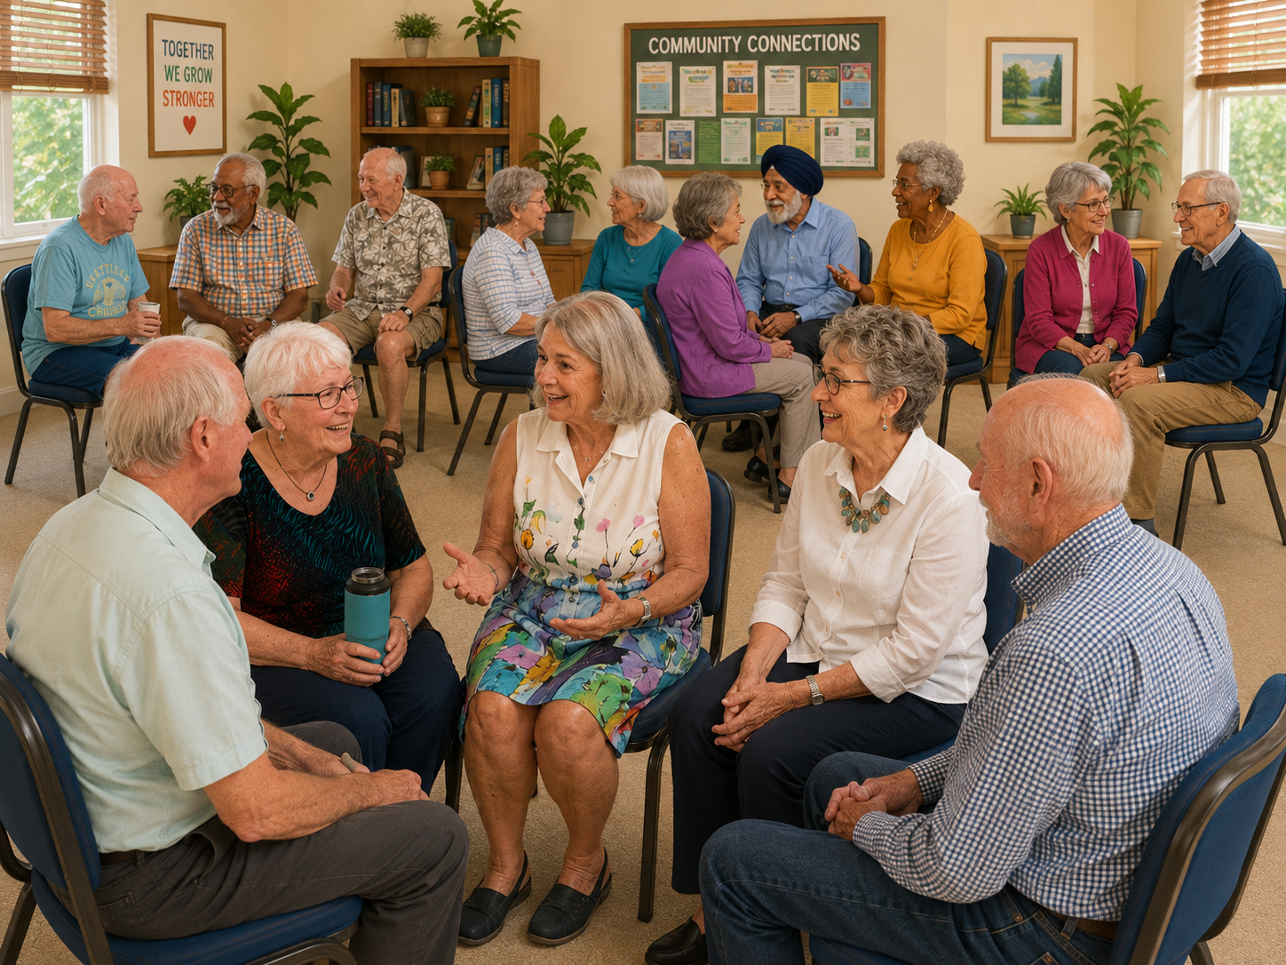
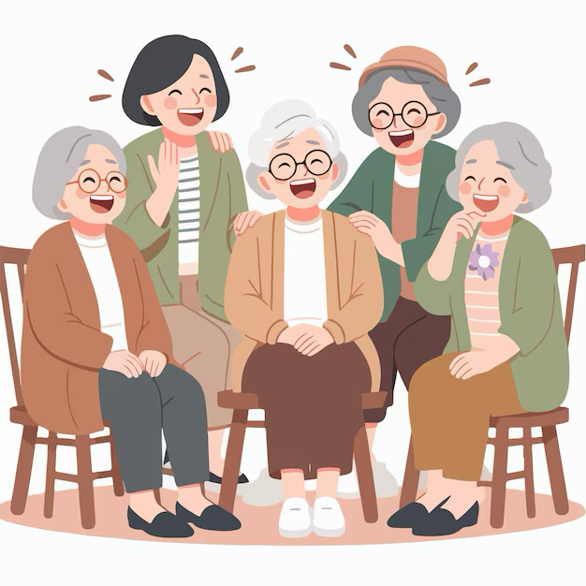
BORDERLANDS UU
Community Conversation
August 9, 2026

Slide 2
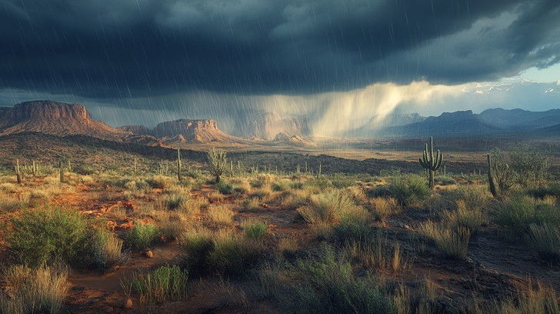
PRELUDE
I Dreamed of Rain

Slide 3
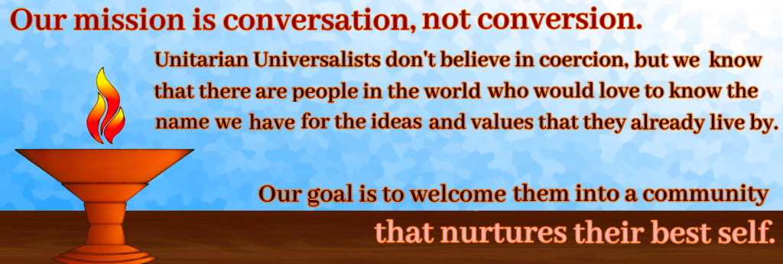
Welcome!

Slide 4
Come, Come Whoever You Are
Come, come whoever you are
Wanderer, Worshipper
Lover of Leaving
Ours is no caravan of despair
Come, yet again, come.

Slide 5
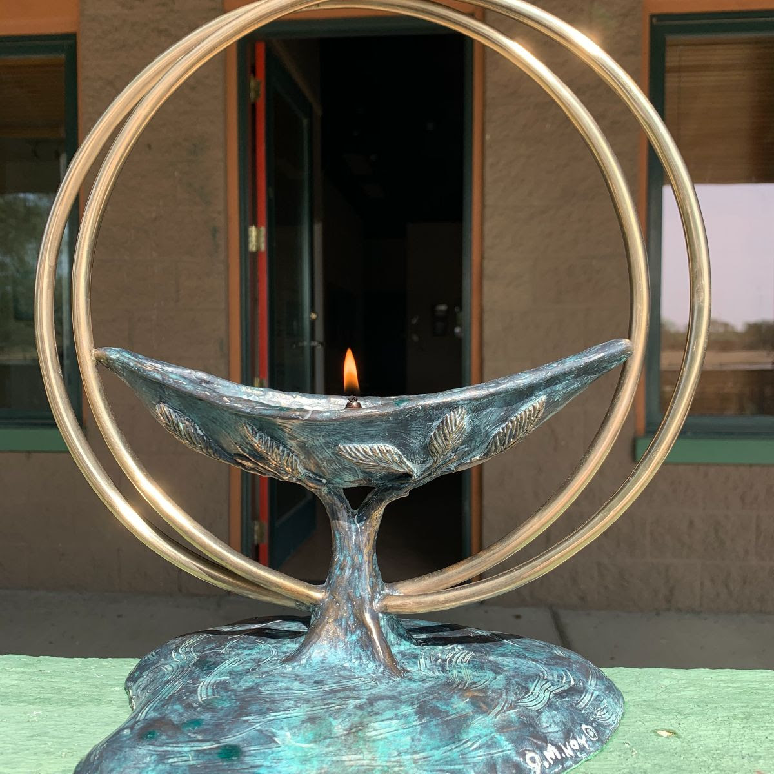
Chalice
Lighting

Slide 6
Together with love we covenant
To respect one another
With our words and actions,
To support this congregation
With our presence, gifts and service
And to care for each other
And the long-term well-being
Of our community.

Slide 7
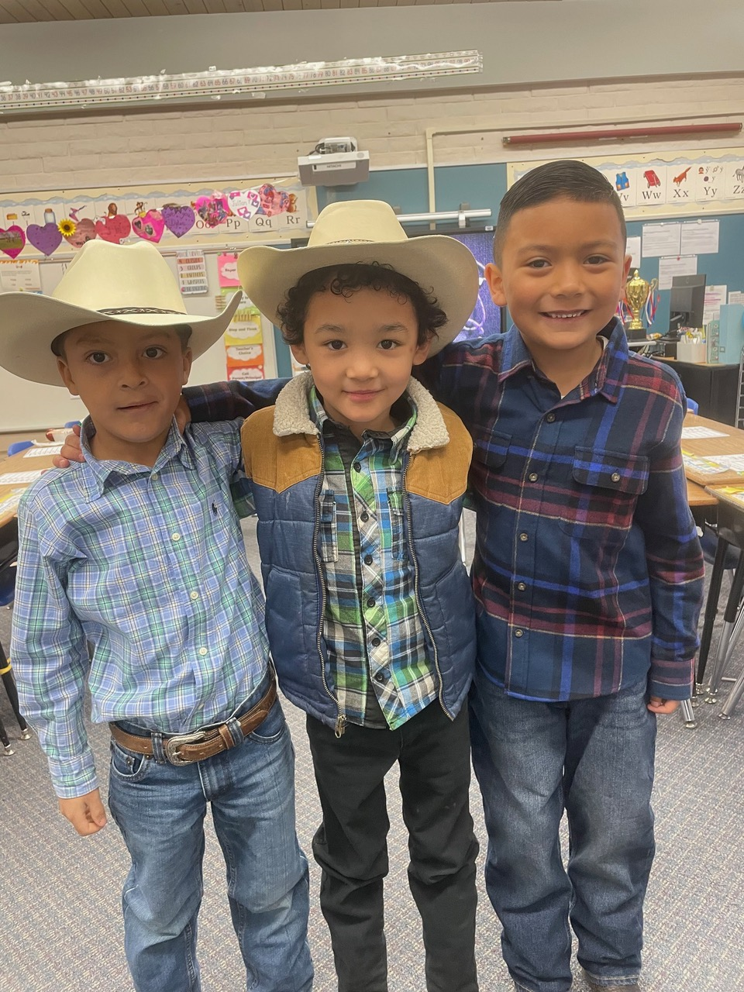
Offertory
Sopori School

Slide 8
With gratitude for the abundance in our own lives we give for the life of this congregation and our community.
Affirmation

Slide 9
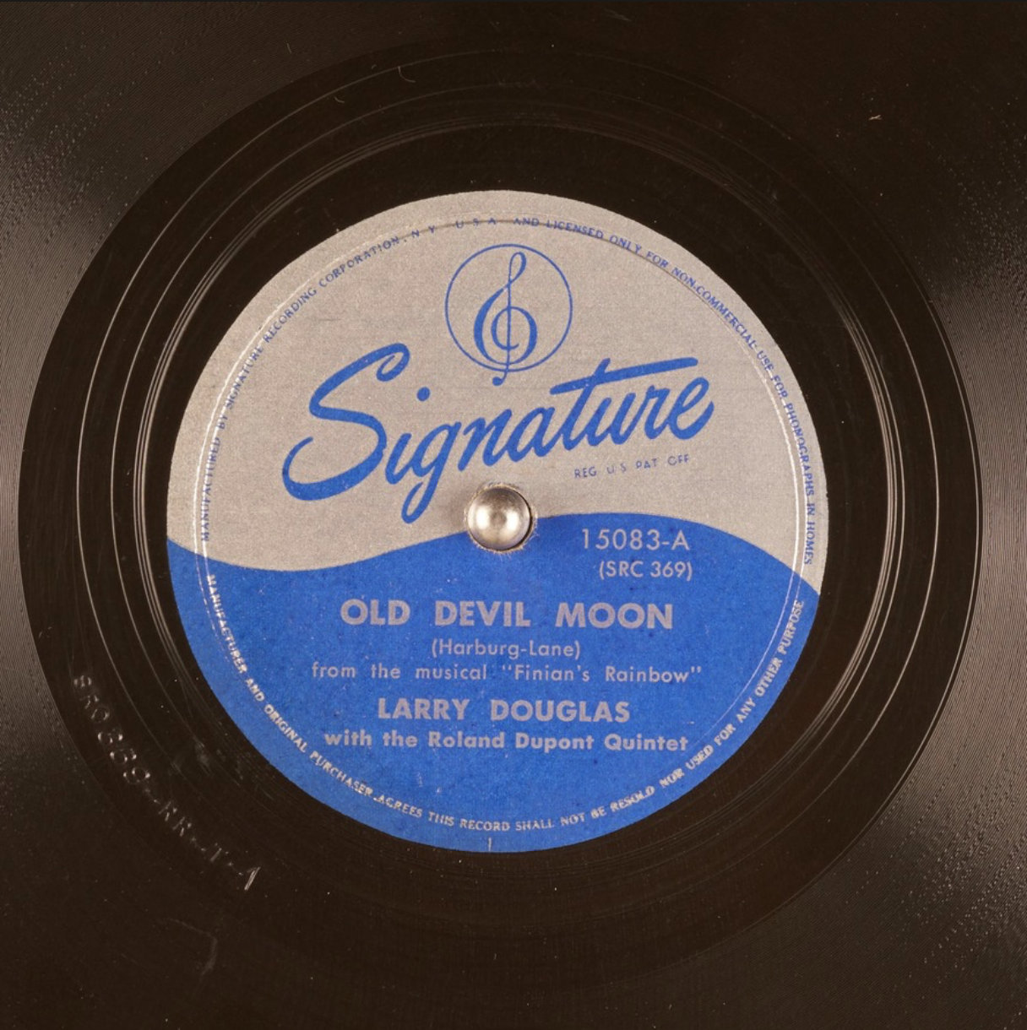
Offertory Music
Old Devil Moon
Choir

Slide 10
Community Conversation
Third Principle:
Accept one another and encourage spiritual growth within our congregation.
Fourth Principle:
A free and responsible search for truth and meaning.

Slide 11
Question 1 (6-7 minutes)
Think about a Sunday Service that was especially meaningful to you.
What made the service meaningful?
Question 2 (6-7 minutes)
As we continue our shared search for truth, meaning, and spiritual growth, what is one thing that might make our Sunday services even more meaningful for you?
Optional question 3 (6-7 minutes)
Do you have any topics you would like to explore in this type of Community Conversation service in the future?
Closing the conversation – (Ringing of the chime)

Slide 12

Spirit of Life, Come to me
Sing in my heart
All the stirrings of compassion
Blow in the wind
Rise in the sea
Move in the hand
Giving life the shape of justice.
Roots hold me close
Wings set me free
Spirit of life
Come to me, come to me

Slide 13

Fuente de amor
Ven hacia mí
Y’al corazon
Cantale tu compassión.
Sopla al volar
Sube en la mar
Hasta moldear
La justicia de la vida.
Arráigame, libérame
Fuente de amor
Ven a mí, ven a mí

Slide 14

Chalice
Extinguishing

Slide 15

Postlude

Slide 16

Benediction

