Slide 1
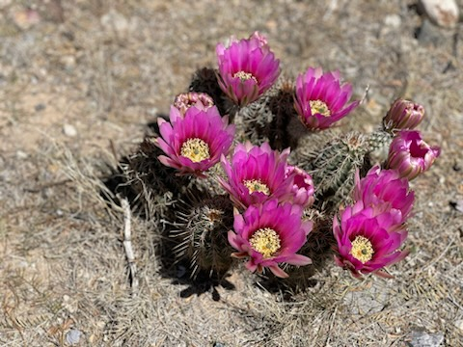
Welcome to Borderlands Unitarian Universalist!
Amado, AZ
August 31, 2025

Slide 2

Together with love we covenant:
To respect one another with our words and actions,
To support this congregation with our presence, gifts, and service, and
To care for each other and the long-term well-being of our community

Slide 3
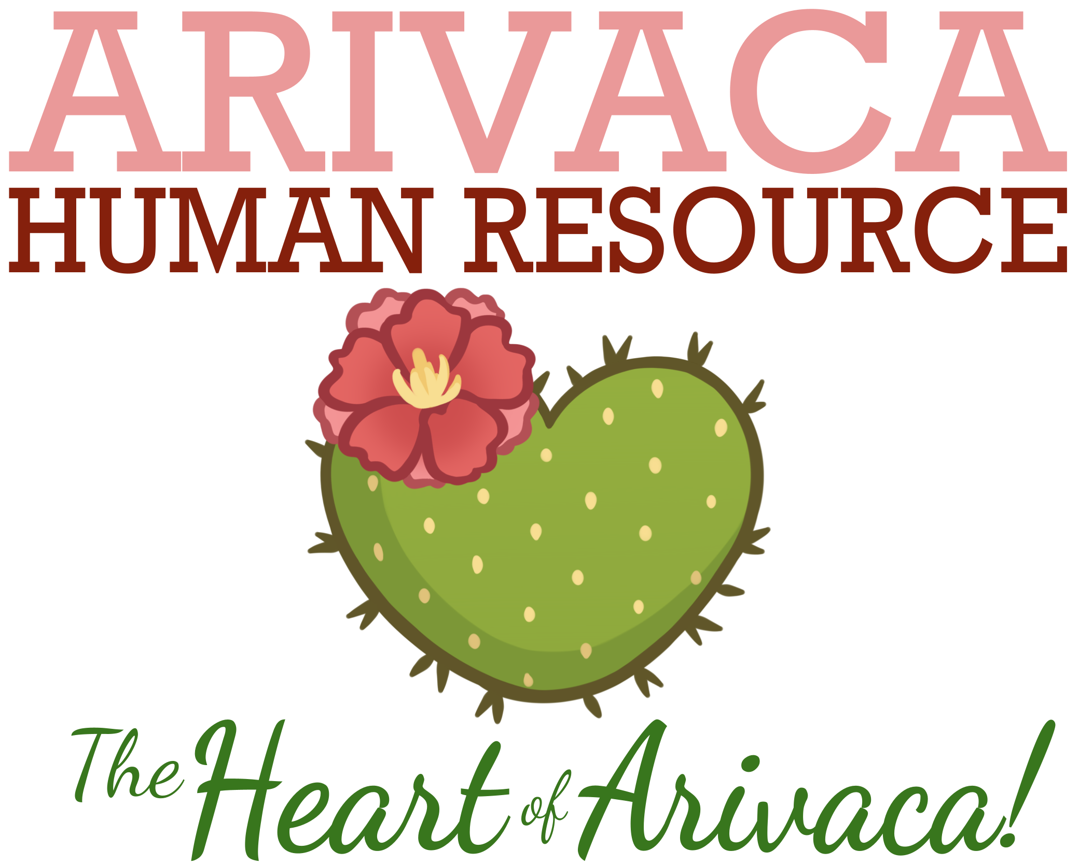
SHARE THE OFFERING AUGUST, 2025
Arivaca Human Resource “provides essential quality of life services and resources” to the Arivaca community, including 75 hot meals Monday through Friday to those in need. In addition, they provide food boxes, energy and rental assistance, emergency financial aid, and community resource and referral information.

Slide 4
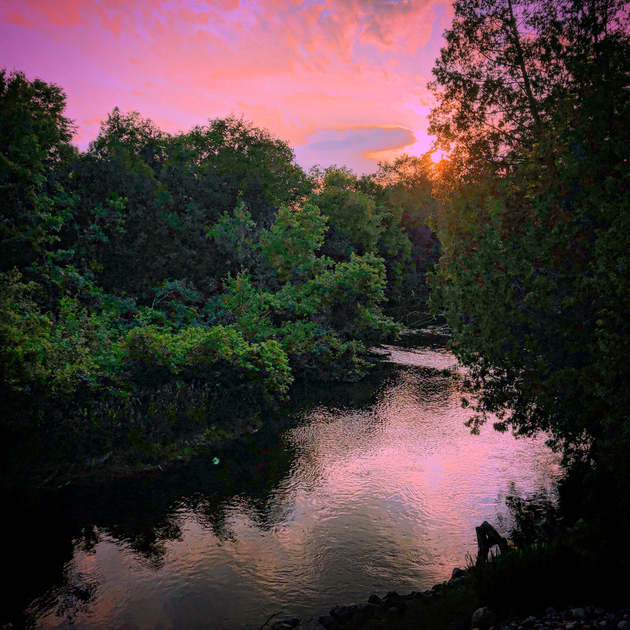
Spirit of Life, come unto me.
Sing in my heart all the stirrings of compassion.
Blow in the wind, rise in the sea; move in the hand, giving life the shape of justice.
Roots hold me close; wings set me free;
Spirit of Life, come to me, come to me.

Slide 5
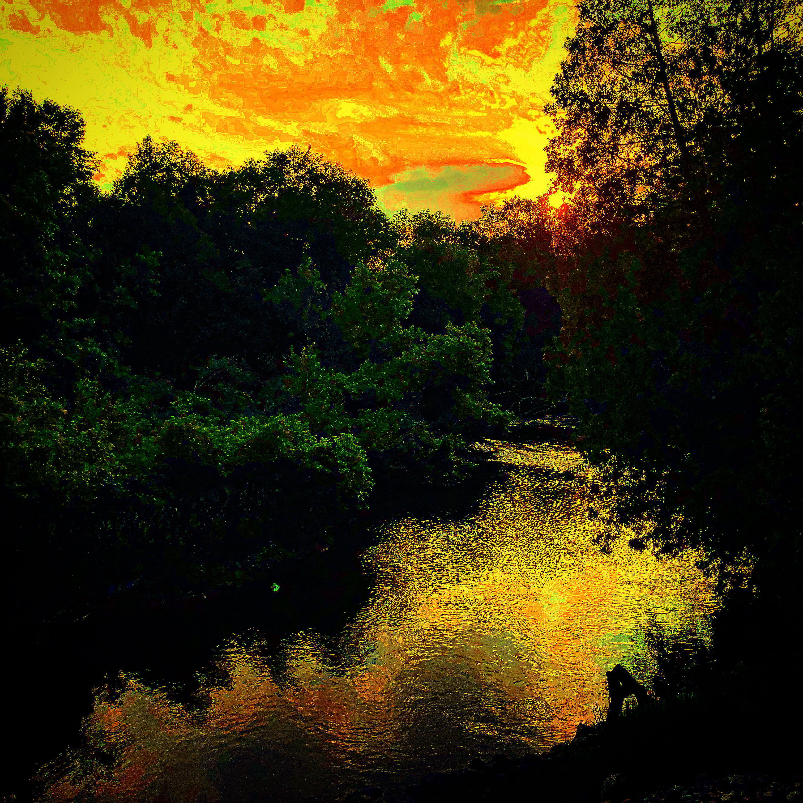
Fuente de-Amor, ven hacia mí.
Y’al corazón, cántale tu compasión.
Sopla-al volar, sube-en la mar, hasta molde-ar la justicia de la vida.
Arráigame, libérame,
Fuente de-Amor, ven a mí, ven a mí.

